Slide 1

CE29204
Group 17

Slide 2
MOORA
Multi-Objective Optimization on the Basis of the Ratio Analysis Method (MOORA) is developed by Brauers and Zavadskas in 2006. The method has been successfully employed for the various problems such as material selection, performance evaluation in real estate sector and contractor selection, design selection, robot selection, personnel selection, quality control, dynamic scheduling in production systems, location selection, firm selection, healthcare waste management, etc. MOORA uses a ratio system in which each response of an alternative on an objective is compared to a denominator, which is representative for all alternatives concerning that objective.

Slide 3


1
•Identification of alternatives and criteria
2
•Develop the initial decision matrix
The procedure of MOORA
3
•Develop a ratio system and apply to compare each performance measure of an
alternative on a criterion to a denominator which is a representative for all the
alternatives concerning that criterion.
4
•Calculate the assessment values of all alternatives
5
•Determine complete ranking of alternatives based on the values

Slide 4

Step-by-Step Procedure of MOORA

Slide 5
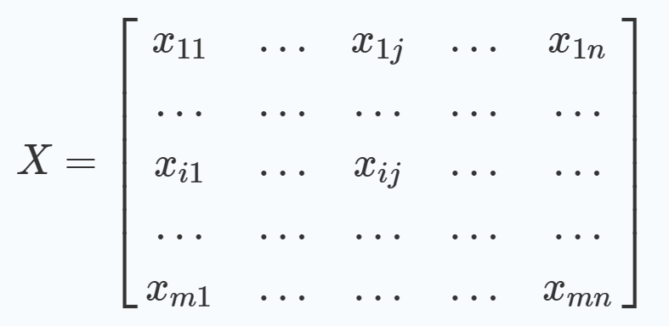
Step 1.
Decision matrix which shows values of different alternatives for different
objective is created
In this, matrix xij shows the value of alternative i according to objective or
criteria j. m is the number of alternatives and n is a number of objectives or criteria.
02

Slide 6
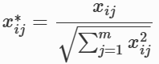
Step 2.
Due to differences in criteria, values of measurements have different units. Normalization is required so that values of measurements transform into dimensionless numbers. These dimensionless numbers are in [0, 1] interval so that commenting is very easy. Normalized values are showed with x∗ij
According to Eq normalized value is obtained dividing alternative’s value by squared root of sum of alternative’s squares.

Slide 7
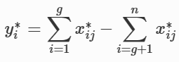
Step 3.
According to ratio system, ranking value can be determined as below.
This equation determines difference between sum of to maximize criteria and sum of to minimize criteria. Attained yi* values are ranked and the alternative has biggest value is selected as the best alternative.

Slide 8
11.4 Advantages of MOORA
•The decision maker can easily apply this method to evaluate the alternatives and select the most suitable one while being completely unaware of the physical meaning of the decision-making process.
• Unlike the other MCDM methods, it employs separate mathematical models to benefit the non-benefit criteria and accommodates graphical qualitative criteria of the decision matrix. Due to this added advantage, in MOORA method, the chance of losing information is very small.

Slide 9
Limitations of MOORA
• Specially while assigning weight to the alternatives, it’s quite difficult to predict weights given to various criteria. In select situations, an unmanageable number of pairwise comparisons of attributes and alternatives with respect to each of the attributes makes the process highly complex.
• As the number of alternatives increases, the amount of calculations rises quite rapidly and computational procedures become quite elaborate.

Slide 10
EXAMPLE
A person wants to travel from place A to place B.
So he needs to choose a mode of transportation. There are many alternatives to choose like bicycle, bike, car, bus, train , boat. He needs to follow some criteria to find out the best alternative. Some of those criteria can be Safety, Cost, Time, and Comfort.We also need to know what is the most important criteria or weight of each criteria and which criteria should be high (+ve) and which one should be less(-ve).

Slide 11
Table 1
Comparative Matrix
Criteria/ Alternative | Safety | Cost | Time | Comfort
Bicycle | 1 | 1 | 5 | 1
Bike | 1 | 4 | 1 | 3
Car | 3 | 5 | 1 | 5
Bus | 3 | 3 | 3 | 3
Train | 4 | 3 | 2 | 2
Boat | 1 | 2 | 4 | 2
Criteria | Weight
Safety | 5
Cost | 3
Time | 4
Comfort | 2

Slide 12
Normalized dimensionless decision matrix
Criteria/ Alternative | Safety | Cost | Time | Comfort
Bicycle | 0.16439 | 0.125 | 0.66815 | 0.13867
Bike | 0.16439 | 0.5 | 0.13363 | 0.41602
Car | 0.49319 | 0.625 | 0.13363 | 0.69337
Bus | 0.49319 | 0.375 | 0.40089 | 0.41602
Train | 0.65759 | 0.375 | 0.26726 | 0.27735
Boat | 0.16439 | 0.25 | 0.53452 | 0.27735

Slide 13
Ranking Table
Alternative | Ranking
Bicycle | -0.26539
Bike | -0.05168
Car | 0.196384
Bus | 0.077792
Train | 0.223856
Boat | -0.205632
The alternative which has the highest value is selected as the best alternative
Here , by observing the ranking value we can conclude that Train is the best alternative way to travel according to the person's interests and criteria.
Thus, in this way by using Multi -Objective Optimization on the Basis of Ratio Analysis we can choose the best alternative with the help of different criteria.

Slide 14


